Slide 1
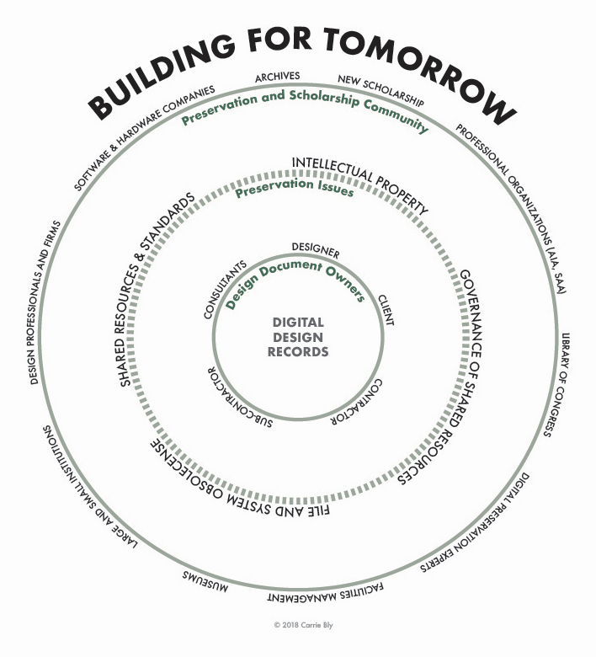
SAA Research Forum
August 2018
Ann Whiteside
awhiteside@gsd.harvard.edu
Notes:
Hello. It’s great to be here to talk about Building for Tomorrow, and to receive input from you while I am here. Building for Tomorrow is about preserving born- digital architecture, design, and engineering records.

Slide 2
Why?
Saving digital design documentation has many complexities
proprietary software
mathematical algorithms that depend upon layers of data to render information
a rapidly growing need to preserve digital information
need for technological tools
need for technical expertise in digital preservation
AutoCAD expertise
archival expertise
need for repositories that can preserve and disseminate the archived data.
Notes:
There are a lot of complexities with design records – including the software, the expertise required to assess the files from the software, preservation issues, the need for repositories, and there are legal issues as well. That names a few of the full set of issues.
The software allows for amazing design because it includes layers and mathematical algorithms and allows designers to create amazing buildings. These complex designs then result in complicated files that require one to understand how the layers are connected, and how versions are connected, and changed. None if this is visible without understanding the software itself.
We are faced with a growing body of these digital records, and we don’t yet have standards for taking in these records.
We also have the opportunity to leverage expertise from other domains outside the design and engineering fields – digital preservation, technologists, those with CAD expertise, archival expertise. And we need the creators and historians to work on this with us.
The variety of expertise required indicates that no one institution, or every collecting institution will be able to, or should, provide their own solutions.
The wide variety of expertise that already exists just begs for a network of communities that can work together to develop shared solutions for this problem.

Slide 3
Building for Tomorrow
The Frances Loeb Library at the Harvard University Graduate School of Design received an IMLS National Forum Grant under the National Digital Platform funding priority. This grant has supported a forum for engaged stakeholders, two meetings to gather the steering committee, and time for research and coordination. As the work of the project moves forward new funding sources will be needed.
IMLS Grant LG-73-17-0004-17
Notes:
The Frances Loeb Library at the Harvard Graduate School of Design received an IMLS grant in in 2017 and 2018 to bring together a wide variety of stakeholders to assess ways in which we can leverage expertise across communities and to develop shared solutions that will help small and large institutions preserve digital design documentation.
The grant is a next step in the line of work that has been happening in this community for a while. The Design Records Section has been publishing information; there is a workshop happening today across the hall. And there are previous projects that highlighted the need for collaborative work, specifically the Kristine Fallon project at the Art Institute of Chicago, and the FAÇADE project at MIT.

Slide 4
Goal
Advance the preservation of digital design data by making it available to a variety of types and sizes of architectural museums, archives and next generation users. Without attending to these issues, the work of design offices worldwide will lack the robust support system necessary to allow current and future scholars access to their work. Such digital design work includes PDFs as well as Building Information Models, proprietary code or software, families of files linked together and even viewing the organization of such files as a whole.
Notes:
The goal, or goals, of the grant are to move the needle forward in this complexing problem that we’ve been grappling with for some time. And to bring communities together to make the work sustainable.

Slide 5
April 2018 Forum
29 representatives:
Architectural practice, architectural history, librarians/archivists, technologists, digital preservation, digital repositories; allied projects
1.5 day workshop
Focused on identifying the challenges of preservation of architectural and engineering documentation, identifying partner communities, lifecycle models that can be adopted, laying out a roadmap for achieving shared resources and infrastructure pieces required to support multiple types and sizes of institutions.
Notes:
The Building for Tomorrow Forum was held in April 2018 at the beginning of the Society of Architectural Historians annual conference, which was held in St. Paul, Minnesota. We brought together representatives of the stakeholder communities and a couple of representatives of allied projects that we need to work on this problem.
For one and a half days, we identified the challenges –both technical and human, we identified the communities we need to partner with, and those not in the room at the Forum. We also assessed lifecycle models to frame our work, and we laid out a roadmap, or set of strategic directions that we can take to start creating an “infrastructure”. I mean by infrastructure technical, and human, standards, and legal expertise that will move us forward.

Slide 6
Forum Outcomes
Digital Architecture, Design, and Engineering (DADE) Strategic Directions and Priorities
DADE Coalition
Notes:
We came up with a name – DADE – Digital Architecture, Design, and Engineering.
But what we really did was to develop a set of strategic directions. Much like a strategic plan, actually, that involves the spectrum of communities we have been working with.
And we agreed we need to form a network or coalition of people from the architectural archives community, allied communities, and identified other initiatives that are working in similar areas on similar issues from whom we can learn and with whom we can collaborate.

Slide 7
Strategic Directions - DRAFT
Representing/Synthesizing the Current State of the Field
(July 2018 - December 2018)
Start and Improve Coordination across Institutions on DADE and Connect to Stakeholders
(July 2018 - June 2019)
DADE Coalition Governance & Sustainability
(July 2018 - June 2019)
Improve the DADE community’s ability and capacity to preserve DADE records
Notes:
This is a high level version of the strategic directions. That is, these are the directions, without the specific actionable work tasks included here. I have a copy of the full list and you can see it at the poster session later today as well.

Slide 8
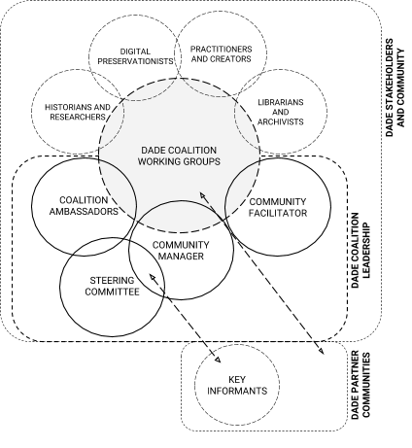
DADE Coalition
An engaged network of stakeholders in the domains of design practitioners, libraries and archives, architectural history, digital preservation, intellectual property, and software designers working to support the long-term needs of DADE preservation for design firms and collecting institutions.
The coalition is a community around DADE digital preservation and digital preservation tools.
Notes:
I mentioned that we want to build a network. Since the Forum, a steering group has come together once in person and virtually since then to refine the strategic directions and to begin laying out a structure around Building for Tomorrow.
We’re calling it the DADE Coalition.
This graphic is currently how we envision the coalition. It’s a structure that is comprised of the steering group with the various communities around us, feeding into the work of preserving these records.

Slide 9
What is Building for Tomorrow Becoming?
Building for Tomorrow is an interdisciplinary group working to develop a preservation and stewardship network for archiving digital design documents: DADE Coalition.
Issues the digital archiving community currently face include: intellectual property rights, training and access for users of digital archives, file and software obsolescence, coordinating archival standards across institutions.
Notes:
So, where are we going and what are we doing?
The Steering group is made up of representatives from a spectrum of allied fields – architectural historians, archivists, technologists, digital preservationists.
We want to fill out the steering group further to ensure representation from other important partner groups.
We are looking to our communities to identify individuals and groups eager to work with us on specific aspects of the strategic plan, and to help us accomplish the work of developing shared solutions for preservation of architecture, design, and engineering records.

Slide 10
Next Steps
Beginning work on strategic directions
Working with Stakeholders and Communities
The stakeholder communities for DADE preservation include:
Librarians and Archivists (owners/stewards of the material)
Approach: long-term preservation, access and scholarship
Practitioners and Creators (creators of the material)
Approach: knowledge management, research, short-term preservation
Historians and Researchers (users of the material)
Approach: scholarship, research
Digital Preservationists (stewards of the material’s substrates and support-systems)
Approach: mutual interest in digital preservation topic
Notes:
We are actively working on the first pieces of the strategic directions, with a focus on working with stakeholders and communities. We have an extension for this grant that will provide us with funds to do further outreach work.
We are also working on many fronts and I will name just a few here:
Effort Map: Create an inventory/map of allied digital curation efforts that may inform DADE good practice (inclusive of other domains)
»»Compile and synthesize collection development policies from collecting institutions
»»Understand how different types of institutions curate, collect, and preserve DADE
Create a Statement of Importance which defines issues and opportunities in developing DADE collections that: articulates the value of participation, frames the scope of activities, and purpose for the DADE community;
»»Create a web presence for DADE;
»»Develop a Community Engagement Plan
And we are looking for funding that will help to sustain this work while we grow.

Slide 11
Thank you
Contact Information
Project Website: https://projects.iq.harvard.edu/
Email: awhiteside@gsd.harvard.edu
Notes:
Please come to the poster session and learn more.
Thanks.

